Slide 1



Day 1- Day 5 Advance Core Java, Maven and Ant Introduction, Java 8/9 new features

Slide 2


Learn Advance Java
Course Content
Advance Java Programming (Duration -23.5h)
Collections And Generics
Inner Classes
Annotations
Threads Basics
Java 8 new features
Ant and Maven Introduction (Duration -7.5h)
Introduction to Build Tools
Ant Introduction And Setup
Run Sample Build from Ant
Maven Introduction And Setup
Create And Build Maven Project
Objective
Learn Advance Java
Learn Maven Fundamentals
Learn Ant Fundamentals

Slide 3

Module Plan
Day | Activities
Day#1 | Exception, Threads and Essential classes | Java Collection Framework | Java Fundamentals: The Core Platform
Day#2 | Java Fundamentals: The Core Platform | Advance Java
Day#3 | Advance Java | Build Tools - Ant And Maven | Ant Tutorial | Maven Tutorial | Maven Fundamentals
Day#4 | New Features in Java 8 | New Features in Java 9 | Assignment#1
Day#5 | Assignment#1

Slide 4


Study Material
Books
Exception, Threads and Essential classes [3h 30m]
Java Collection Framework [2h 30m]
Ant Tutorial [1h 30m]
Maven Tutorial [1h 30m]
Video Material
Java Fundamentals: The Core Platform [7h 25m]
Java Generics [4h 15m]
Maven Fundamentals [2h 30m]
New Features in Java 8 [4h 15m]
New Features in Java 9 [3h 33m]

Slide 5

Assignment
Assignment # 1

Slide 6
Problem Statement
Implement a standalone flight search program in Java that lists matching flights for a traveller who is looking to fly between 2 locations on a given date. The input locations should be 3 letter location code format as present in airlines flight data.
You are given 3 CSV files, each containing the available flight data for Air India, Jet Air, IndiGo respectively. Sample CSV files links are attached here for reference. You can add more data in existing files or can add more CSV files for another airlines.
Air India Data
Jet Air Data
Indigo Data

Slide 7
Problem Statement…
CSV File Data Details
CSV Fields | Details
FLIGHT_NO | Unique flight number, starting with 2 letter airline code
DEP_LOC | Departure location code
ARR_LOC | Arrival location code
VALID_TILL | Date (DD-MM-YYYY) till which each flight is available. It means that this flight will fly once everyday till this date
FLIGHT_TIME | local time (HHmm) at which flight departs from departure location
FLIGHT_DUR | Flight Duration from departure location to arrival location
FARE | This is the fare of the flight per person in INR
SEAT_AVAILABILITY | Y or N
CLASS | E or B or EB [E- economic, B- Business]

Slide 8
Problem Statement
Input
Program should accept 5 input parameters
Departure Location
Arrival Location
Flight Date
Flight Class
Output Preference
“Flight Class” is a String which has two possible values like ‘E’ and ‘B’. E=Economic and B=Business.
“Output Preference” is a String which suggests whether flight result should be sorted only by fare or by both fare and flight duration.

Slide 9
Expected Behaviour and Output
After getting the inputs, program should search for the flights in all 3 csv files and list the results on standard output, sorted by Fare and Flight Duration
Program should be written considering that there could be more csv files and at runtime program should load the files. Please make use of Thread which will look for any new file at a particular configurable location after some configurable time and load the provided file
If the Departure location or/and Arrival location is not present in any csv files, then program should return a user-friendly error
Assignment should be implemented as a Maven project.
Maven 3.x should be used.
Use available 3rd party dependencies to read and parse CSV files.
Write an ant script to build a jar file for the same java program
Use the new features of Java 8 wherever possible
Output
Program should display the list of available flights with details on console for provided user inputs and if user enters “Flight Class” as ‘B’ then fare should be increased by 40% of the base fare.(CSV file has the base fare only)

Slide 10
Evaluation Criteria
Code Completeness and Correctness
Use of Java Collections, Threads and Annotations
Usage of OO Principles, package/class structure, class/function/variable names
Code in running condition
Face to face discussion
Usage of Java 8 new features

Slide 11



Day 6- Day 9 – JDBC,ORM and Hibernate

Slide 12
Learn JDBC, ORM basics and Hibernate
Course Content
JDBC
How to setup JDBC?
JDBC Connections, Statements, Result Sets
JDBC Transactions, Exceptions, Batch processing
ORM And Hibernate
ORM Fundamentals
Hibernate Env. Setup
Define Hibernate Mappings
Use Hibernate for CRUD Operations
Objective
Learn JDBC Usage
Learn ORM Framework

Slide 13
Study Material
Books
JDBC Tutorial [5h]
Hibernate Tutorial [7h]
Video Material
Install MySQL on Windows [6m]
Java Persistence with Hibernate Fundamentals [3h]

Slide 14
Module Plan
Day | Activities
Day#6 | Install MySQL on Windows | JDBC Tutorial | Hibernate Introduction
Day#7 | Hibernate Introduction | Hibernate Tutorial
Day#8 | Hibernate Tutorial | Assignment#2
Day#9 | Assignment#2

Slide 15
Assignment
Assignment # 2

Slide 16
Problem Statement
Implement a standalone flight search program in Java, using Hibernate that lists matching flights for a traveller who is looking to fly between 2 locations on a given date. The input locations should be 3 letter location code format as present in airlines flight data.
You are given 3 CSV files, each containing the available flight data for Air India, Jet Air, IndiGo respectively. Sample CSV files links are attached here for reference. You can add more data in existing files or can add more CSV files for another airlines. The data from these files needs to be persisted in the database. All the search operations for the flights will be done on the database using hibernate.
Air India Data
Jet Air Data
Indigo Data

Slide 17
Problem Statement…
CSV File Data Details
CSV Fields | Details
FLIGHT_NO | Unique flight number, starting with 2 letter airline code
DEP_LOC | Departure location code
ARR_LOC | Arrival location code
VALID_TILL | Date (DD-MM-YYYY) till which each flight is available. It means that this flight will fly once everyday till this date
FLIGHT_TIME | local time (HHmm) at which flight departs from departure location
FLIGHT_DUR | Flight Duration from departure location to arrival location
FARE | This is the fare of the flight per person in INR
SEAT_AVAILABILITY | Y or N
CLASS | E or B or EB [E- economic, B- Business]

Slide 18
Problem Statement
Input
Program should accept 5 input parameters
Departure Location
Arrival Location
Flight Date
Flight Class
Output Preference
“Flight Class” is a String which has two possible values like ‘E’ and ‘B’. E=Economic and B=Business.
“Output Preference” is a String which suggests whether flight result should be sorted only by fare or by both fare and flight duration.

Slide 19
Expected Behaviour and Output
After getting the inputs, program should search for the flights in the database and list the results on standard output, sorted by Fare and Flight Duration
Program should be written considering that there could be more csv files and at runtime program should load the files. Please make use of Thread which will look for any new file at particular location after some configurable time and load the provided file
If no matching flight is found for the given input, user friendly output should be displayed on the screen.
Maven 3.x should be used
Use the new features of Java 8 wherever possible
Output
Program should display the list of available flights with details on console for provided user inputs and if user enters “Flight Class” as ‘B’ then fare should be increased by 40% of the base fare.(CSV file has the base fare only)

Slide 20
Evaluation Criteria
Code Completeness and Correctness
Database design and use of hibernate technology
Use of Java Collections, Threads and Annotations
Usage of OO Principles, package/class structure, class/function/variable names
Code in running condition
Face to face discussion
Usage of Java 8 new features

Slide 21



Day 10 – Day 13 Web Server Basics And Web Components

Slide 22
Web Server And Components
Course Content
Web Server Basics(Duration -5h)
Web Server And Application Server Introduction
Know About Tomcat
Configure Tomcat with Eclipse
Web Components (Duration -15h)
JSP And Servlet Basics
JSP Standard Tag Library [JSTL]
Web Application Structure
Sample Web Application
Objective
Web Server And Application Server Basics
Learn Web Components
Develop Web Application

Slide 23
Module Plan
Day | Activities
Day#10 | Webserver And Application Server Basics | Tomcat Basics | Tomcat Advanced | Configuring Tomcat in Eclipse Pdf | Java Web Fundamentals
Day#11 | Creating a Web App Using Eclipse | JSP And Servlet Tutorial | Servlet Tutorial
Day#12 | JSP Tutorial | Assignment#3
Day#13 | Assignment#3

Slide 24
Study Material
Books
Tomcat Basics [2h]
Tomcat Advanced [2h]
Configuring tomcat in eclipse [1h] –(Study Material)
Servlet Tutorial [4h]
JSP Tutorial [4h]
Video Material
Creating a Web App Using Eclipse [15m]
JSP And Servlet Tutorial [4h]
Java Web Fundamentals [2h 28m]

Slide 25
Assignment
Assignment # 3

Slide 26
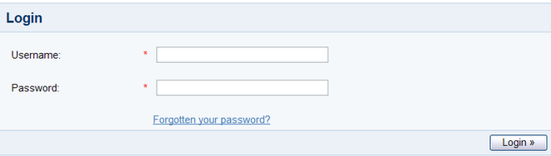
Problem Statement
Develop an image management utility. This utility begins by presenting a login screen that looks like this
User would enter a username and password for authentication. Upon clicking the Login button, the submitted username / password should be verified (authenticated) against existing users' information in the database.
Upon successful authentication, the user would be presented with a screen as follows:

Slide 27
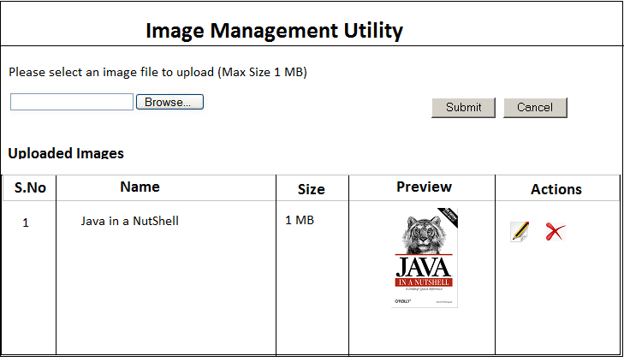
Problem Statement…
User should be allowed to edit (change the uploaded image’s attributes viz. name, image source) and delete the image and total size of the uploaded images should be displayed at the bottom of the listing on the same page.

Slide 28
Expected Behaviour
Constraints
Max size of a single file uploaded should be 1 MB
Max size of all uploaded files should be 10 MB
Key Points
Design appropriate data model and object model
Proper validation and info messages should be shown on console wherever required
Exception Handling is required
Make use of Hibernate Technology for Data Base connectivity
While writing APIs no SQL scripts should be used instead use Hibernate POJOs and HQL
Tomcat version 8 or above and hibernate 5.x should be used.

Slide 29
Evaluation Criteria
Code Completeness and Correctness
Usage of OO Principles, package/class structure, class/function/variable names
Code Modularity
Code should be in running condition
Face to face discussion
Data base design and proper use of hibernate technology
Ability to deploy WAR application on application server without using IDE
Adhere to Java Coding Standards And Guidelines

Slide 30

Day 14- Day 17 Spring and Spring Hibernate Integration

Slide 31

Spring And Spring Hibernate Integration
Course Content
Spring Basics (Duration 7h)
Introduction
Spring Architecture
Spring Env. Setup
Write a small “Hello world” Example
Objective
Develop Web Application using Spring
Spring Hibernate Integration
Understanding Coding Guidelines and Best Practices
Spring Core (Duration 24h)
IOC/Dependency Injection
Validation, Data Binding and Type Conversion
Spring AOP
Transaction Management
Spring MVC
Spring JDBC Framework
Hibernate with Spring

Slide 32
Module Plan
Day | Activities
Day#14 | Spring Env Setup | Spring Fundamentals | Web Applications with Spring |Spring Tutorials Pdf [Spring Architecture]
Day#15 | Spring with JPA and Hibernate | Spring MVC Introduction
Day#16 | Spring Hibernate Integration | Spring Framework Reference | Assignment#4
Day#17 | Assignment#4

Slide 33
Study Material
Books
Spring Tutorial [5h]
Spring-framework-reference [8h] – (Study Material)
Video Material
Spring Fundamentals [2h 55m]
Web Applications with Spring [2h]
Spring with JPA and Hibernate [5h]
Spring MVC Introduction [4h]
Spring Hibernate Integration [1h 13m]

Slide 34
Assignment
Assignment # 4

Slide 35
Problem Statement
Extend Assignment #2 to implement a flight search Web Application using Spring, Hibernate technology that lists matching flights for a traveller who is looking to fly between 2 locations on a given date.
Instead of providing input on console, users will use a web application to input. The web application has to be developed using Spring MVC. Spring and Hibernate integration has to be implemented.

Slide 36
Problem Statement
Input
Program should accept 5 input parameters
Departure Location
Arrival Location
Flight Date
Flight Class
Output Preference
“Flight Class” is a String which has two possible values like ‘E’ and ‘B’. E=Economic and B=Business.
“Output Preference” is a String which suggests whether flight result should be sorted only by fare or by both fare and flight duration.

Slide 37
Expected Behaviour And Output
Program should be written considering that there could be more csv files and at runtime program should load the files. Please make use of Thread which will look for any new file at particular location after some configurable time and load the provided file
Create a login Page for the application and after successful login Flight Search Screen will be displayed
Search screen should have all input parameters specified in previous slides as Departure Location, Arrival Location, Flight Class, Flight Date, Output Preference
Once Search is triggered after specifying the search parameters, program will display the search results using hibernate
Use Spring MVC and Spring - Hibernate Integration
Spring version 3 or 4 should be used

Slide 38
Evaluation Criteria
Code Completeness and Correctness
Usage of Spring Framework And Hibernate
Code Modularity
Code should be in running condition
Face to face discussion
Application UI Design

Slide 39


Day 18- Day 22 Web Services

Slide 40
Web Service
Objective
Develop Web Application using Spring MVC and Spring boot
Course Content
Basics(Duration 11h)
Introduction
REST Core Components
SOAP Core Components
Advance (Duration 19h)
RESTful Architecture
HTTP methods
Jackson
Validations
Filters
Spring Boot

Slide 41
Module Plan
Day | Activities
Day#18 | REST Webservices Basics | REST Webservices | SOAP | WSDL
Day#19 | SOAP Webservices Basics
Day#20 | Spring Boot Introduction & RESTful API with Spring Boot
Day#21 | Assignment#5
Day#22 | Assignment#5

Slide 42
Study Material
Books
REST Webservices Basics (Refer chap. 20) [4h]
REST Webservices [2h]
SOAP [30m]
WSDL [30m]
SOAP Webservices Basics (Refer chap. 16) [4h]
Further References
Video Material
Your first Spring Boot Application [2h]

Slide 43
Assignment
Assignment # 5

Slide 44
Problem Statement
Develop a web application (Application 1) using Spring MVC and JSP for HR Manager. HR manager can login to application and manage employees.
However the details of the Employees are maintained on a separate server (Application 2) which exposes RESTful webservices using Spring Boot to support CRUD operations on employee data.
Following functionalities are expected
HR Manager Login/Logout
Employee listing
Edit an employee details

Slide 45
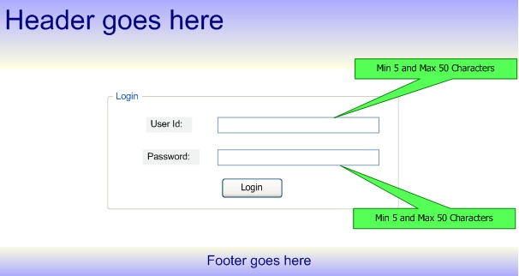
Application UI
HR Manager Login

Slide 46
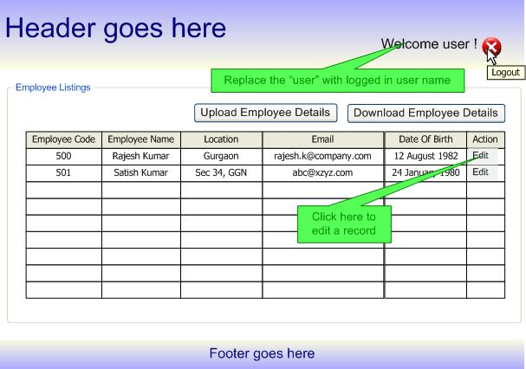
Application UI…
List Employees Details

Slide 47
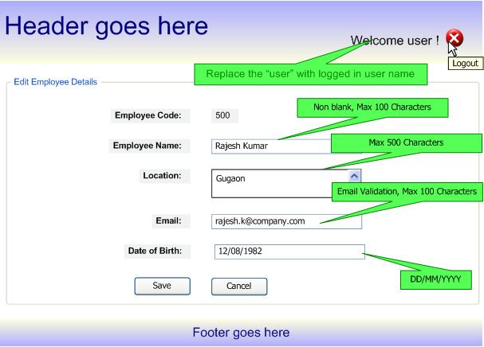
Application UI…
Edit Details

Slide 48
Expected Behaviour and Output
The complete assignment should be done using Spring MVC, Tomcat, Spring Boot and Hibernate only.
Well documented HTML, JS and CSS files
Code should follow Java Coding Standards, Guidelines and best practices
Follow best practices for restful webservices
Use of appropriate HTTP codes and exception handling for REST APIs.
Server to server webservice communication

Slide 49
Evaluation Criteria
Code correctness
Code modularity
Code should be in running condition
Use of Spring Boot
Face to face discussion
Adhere to Java Coding Standards And Guidelines
Implementation of 3-tier architecture

Slide 50


Day 23 - Day 25 DevOps - CI/CD

Slide 51
Web Service
Objective
Create a CI-CD pipeline in Jenkins
Course Content
Build And CI (Duration -11h)
What is CI?
Know About Jenkins
Jenkins Setup
Creating a pipeline
Sonar Setup for Jenkins
Accessing Build And Sonar Reports

Slide 52
Module Plan
Day | Activities
Day#23 | Build and CI-CD
Day#24 | Build and CI-CD | Assignment#6
Day#25 | Assignment #6

Slide 53
Study Material
Books
Jenkins And Sonar Build Process [8h] –
(Study Material)
Further References
Video Material
Introduction to DevOps[1h 20m]
Understanding CI Process with Jenkins[1h]

Slide 54
Assignment
Assignment # 6

Slide 55
Problem Statement
Create CI-CD pipelines for the applications already developed in Assignment #5. Two separate pipelines need to be created; one for Spring MVC application and one for the spring boot application. Only pipelines need to be created and code will be re-used from Assignment #5.
The build should get automatically triggered if there are any new commits in the repository.

Slide 56
Expected Behaviour and Output
The complete assignment should be done using Jenkins and required plugins only.
The pipelines should pass with BUILD SUCCESS.
Assignment submission will be a demo and mentee must present the created pipelines to the respective mentor.

Slide 57
Evaluation Criteria
Pipelines Completeness and Correctness
Pipelines in running condition
Face to face discussion

